Slide 1

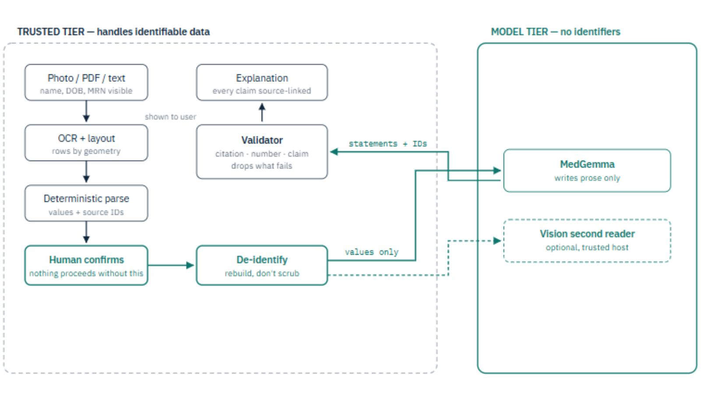
PlainMed
Clear reports. Private by design.
A patient photographs a lab report and gets back an explanation where every sentence points at the line that supports it — and the AI never learns who they are.
Built on Google MedGemma · Served with NVIDIA TensorRT-LLM · Launching India
Notes:
Open holding a paper lab report. 'My mother got one of these and Googled her way to a cancer scare over a value that was fine.' Then: watch.

Slide 2
THE PROBLEM
A patient can read every word and understand nothing
?
!
Neither can do the one thing that matters:
Search the web
Upload to a chatbot
show its source
Results strip away the context of this report — this value, this range, this lab. The worst-case reading wins the click.
The most sensitive document a person owns leaves their device, is cached, and may train a model.
You cannot check an answer you cannot trace.
So patients arrive at appointments anxious about the wrong things — and without the questions that would actually help them.
Notes:
Eight minutes with a doctor. A document they cannot read about a body they own.

Slide 3
WHAT IT DOES
Photograph it. Check it. Understand it.
1
Scan
2
Check
3
Understand
4
Ask
Photograph the paper
report on any phone
→
See exactly what was
read. Correct anything
→
Plain language, every
claim source-linked
→
Questions to take to
your clinician
Nothing is explained until a person confirms what was read.
Confidence tells you the OCR was sure. It does not tell you it was right — so the review step is mandatory, not conditional. It is also where a misread digit gets caught by the one person who can see the paper.
Notes:
Live demo goes here: phone, photo, review screen, explanation. Roughly 1.3 seconds for OCR.

Slide 4
THE CORE IDEA
A generated 13.5 is indistinguishable from a hallucinated 13.5
So the language model is never allowed to produce one.
Parser owns the numbers
Model owns the prose
Validator owns the truth
Every value, unit, range and flag is extracted deterministically. Reproducible, unit-tested, and incapable of inventing a digit.
MedGemma writes the explanation around values that were already extracted. It can improve how this reads. It cannot change what it says.
Cited line must exist. Every number must appear in it. No diagnosis, no treatment advice, no reassurance.
Judges see hallucination demos constantly. PlainMed demonstrates catching one — live, on stage.
Notes:
Demo moment: feed it a statement with a wrong number and a diagnosis, and show the validator dropping both.

Slide 5
ARCHITECTURE
The GPU never learns who the patient is
Cheap GPU marketplaces will not sign healthcare data agreements. So we made the GPU not handle patient data at all.
TRUSTED TIER
MODEL TIER
CPU · handles identifiable data
GPU · no identifiers, no BAA needed
decode → OCR → parse → de-identify
→
Glucose 108 mg/dL (ref 70-99) [H]
Compliance burden lives here — and it is the cheap tier to run.
No name, no DOB, no record number. Verified in CI against 14 identifier categories.
~$0.03/hr
$0.17/hr
values only
The tier that is expensive to comply with is CPU-cheap. The tier that is expensive to run carries no compliance burden.
De-identification is an allowlist, not a scrubber: the text is rebuilt from parsed fields, so a line containing a name never had a path through.
Notes:
Run scripts/deident_check.py live here. 0.36 seconds, 14 identifier categories withheld, clinical content preserved.

Slide 6
GOOGLE
MedGemma, used as a second reader
The obvious build hands the photo to MedGemma and deletes the OCR pipeline. We deliberately did not.
What MedGemma 1.5 4B gives us
How we use the vision encoder
Open weights — runs on hardware we control
It reads the same photo independently — a second radiologist, not a replacement for the first.
Medically tuned, with document understanding
Readers agree → real confidence
Multimodal: a vision encoder that reads the page
Readers differ → a human is asked
128K context, and a 4B size that fits cheap GPUs
The model can raise a question. It can never overwrite an answer.
Model weights are used under Google's Health AI Developer Foundations terms.
Notes:
This is the novel contribution: using a multimodal medical model as an independent verifier rather than as a generator of facts.

Slide 7
NVIDIA
Served on NVIDIA, priced like a rounding error
The same model behind a TensorRT-LLM engine, without inference concerns leaking into application code.
NIM / TensorRT-LLM
4-bit NF4 weights
FP8, XQA and paged attention behind an OpenAI-compatible API
A 4B model onto a 16 GB commodity card, roughly halving hourly cost
One GPU, two jobs
Degrades, never fails
PaddleOCR and MedGemma share the accelerator — a scan needs one, not two
No GPU available? Validated template explanations still ship
Because the GPU never sees patient data, it does not need a compliance-grade host — so inference costs a fraction of a cent per report.
Notes:
GPU cost will not be the constraint; idle capacity will. Fill in the measured latency and peak VRAM before presenting.

Slide 8
WHERE WE LAUNCH
India first, in the language the patient actually reads
$20.5B
2.5B+
56%
2 → 10
India diagnostics market, 2026
tests/year projected by 2031
of that is pathology — our input
languages, English + Hindi today
Language is a legal requirement, not a feature
Built for DPDP from the start
India's DPDP Act requires the consent notice in English or an Eighth Schedule language. A patient who cannot read the notice cannot consent to it.
✓
Itemised notice before any processing (Rule 3)
✓
Consent withdrawal as easy as giving it
Shipping: English, हिन्दी → Tamil, Telugu, Bengali, Marathi, Gujarati, Kannada, Malayalam, Punjabi
✓
Under-18 excluded and enforced in code
✓
Nothing stored, so nothing to breach
Notes:
India is also a cheaper compliance path than the US or EU: no BAA regime, health data has no special category, and cross-border transfer is permissive.

Slide 9
EVIDENCE
None of this is a claim. Watch it run.
132
1.3 s
3
0
tests passing
photo to values
proofs in CI
bytes stored
parser, validation,
OCR, security
CPU only, before
any GPU
offline, retention,
de-identification
verified from
outside the app
PASS
offline_check
full pipeline runs with every socket blocked
0.55 s
PASS
retention_check
no file written, no report content in any log
2.6 s
PASS
deident_check
14 identifier categories never reach the model
0.36 s
Notes:
Run these live. Terminal printing PASS in under a second beats a bullet point claiming the same thing.

Slide 10
Photograph the report.
Understand it. Own it.
A medical AI that shows its work, and never learns your name.
Working today
Camera to explanation, 132 tests, 3 safety proofs green in CI
Next 60 days
MedGemma on NVIDIA GPUs, clinician review, 5 more Indian languages
The ask
GPU access to move from validated architecture to measured performance
PlainMed · clear reports, private by design
Notes:
Close on the ask. Do not keep talking after this slide.

